Slide 1
Olympic Data Analysis
SQL Project: Exploring Olympic Games Data Through Advanced Queries
By GOBIKRISHNAA S
Data Analytics(SQL) Project 2025

Slide 2
Olympics Dataset Overview
Athlete records from 1896 to 2016
Has 70000 records(rows)
Columns:
Name, Sex, Age, Height, Weight, Team, NOC,
Games, Year, Season, City, Sport, Event, Medal.
Enables SQL analysis on:
- Medal counts & trends
- Athlete demographics
- Country performance

Slide 3
Project Overview
Olympic Dataset Analysis
Comprehensive SQL analysis of Olympic Games data covering medal distributions, athlete performance, and country-wise statistics across multiple Olympic editions.
Medal Analytics
Country-wise medal counts, gold medal trends, and performance analysis
Athlete Insights
Individual athlete performance, streaks, and demographic analysis
Temporal Trends
Year-over-year growth, pre/post 2000 comparisons

Slide 4
Contents
• Data Cleaning
• Aggregations
• Window Functions
• Joins
• Ranking
• Trends
• Country & Athlete Analysis
• Medal Analysis

Slide 5
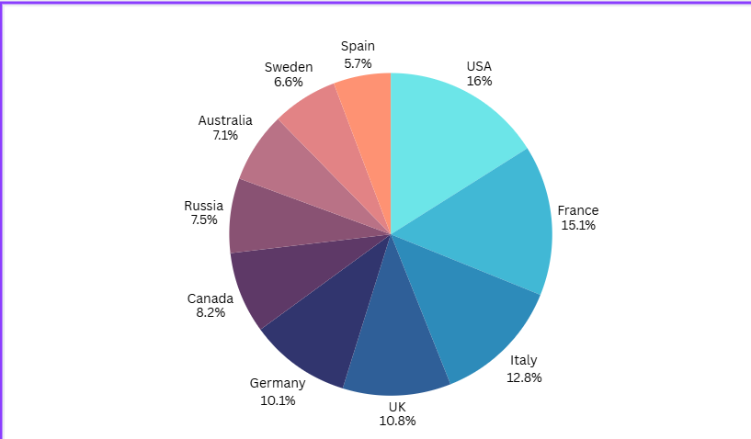
Top 10 Countries by Total Medals
USA (16%) has the largest share, meaning it won the most medals.
France (15.1%) and Italy (12.8%) are also strong performers.
UK (10.8%) and Germany (10.1%) show consistent performance

Slide 6
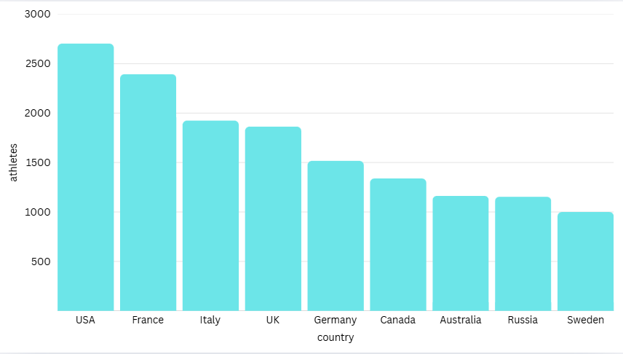
No of athletes from each country

Slide 7
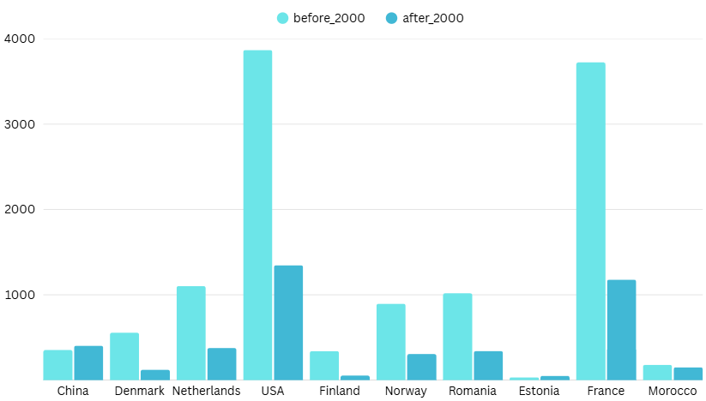
Medal trend pre/post 2000
USA and France have very high medal counts in both periods, showing consistent Olympic dominance.
Some countries like China show stable or slightly improved performance after 2000

Slide 8

Youngest Gold Medalist
Hans Bourquin
The youngest Olympic gold medalist in this dataset(from 1896 to 2016) is Hans Bourquin.
He was just 13 years old when he won a Gold medal.
He represented Switzerland and won the gold medal in the sport of Rowing.

Slide 9
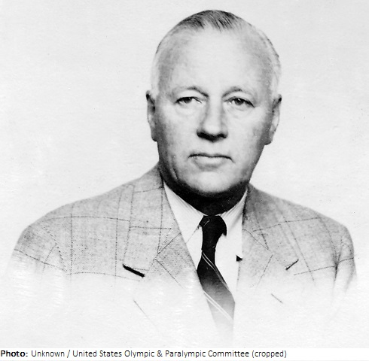
Oldest Gold Medalist
Everard Coenraad Endt
The oldest Olympic gold medalist in this dataset is Everard Coenraad Endt.
He won a Gold medal at the age of 59, representing the United States of America.
He achieved this victory in the sport of Sailing

Slide 10
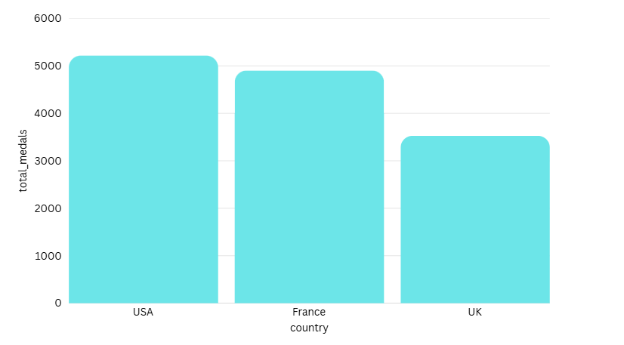
Countries that won medals in every Olympic year
USA has the highest total medal count, showing long-term Olympic dominance.
France is the second highest, with medal performance close to the USA.
UK ranks third, with fewer medals compared to USA and France

Slide 11
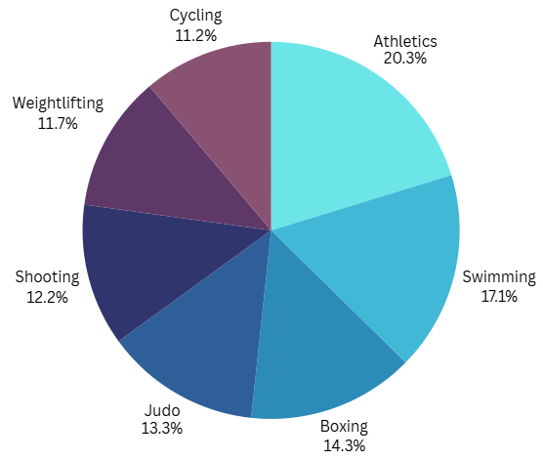
Top 10 Sports with 100+ Countries Participation
These are the sports that have the widest global participation in the Olympic dataset.
Athletics leads with 198 countries Participating in it.

Slide 12
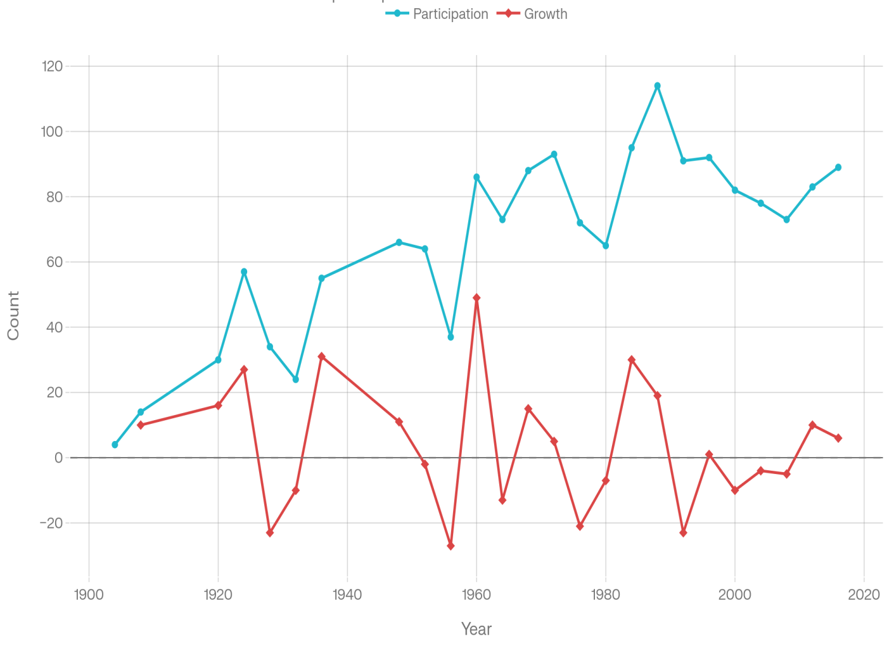
Olympic Boxing Participation and Growth Year by Year(1904-2016)
This graph shows the participation in boxing changed over years.
Participation peaked in 1988 with 114 athletes
Growth peaked in 1960 with 49 athletes compared to previous year(1956).

Slide 13
Conclusion
Through this project I demonstrated real-world SQL skills such as joins, CTEs, Window functions Trend Analysis, Ranking logic,…Etc., from base level to Advanced level Queries.
This Project showcases My ability to analyze large datasets and extract meaningful insights.

